Slide 1



⚖
LAWYER
TYCOON
LSAT PREP, REIMAGINED
BUILT AT UT AUSTIN
Lawyer Tycoon
Student-built.
Evidence-first.
The LSAT speedrun app.
DIAGNOSE · PRACTICE · PROGRESS
Alan Abraham · Nischay Hegde
CO-FOUNDERS
One measured learning loop. No busywork.
Notes:
My name is Alan and I am Nischay, we are from UT austin and our application is Lawyer Tycoon, an LSAT speedrun app. The average student spends 4 months studying for the LSAT. We want to cut that down to half.
Nischay+Alan

Slide 2
Spiky POV
The only efficient way to study for the LSAT is to repeatedly answer questions and receive feedback.
Watching videos or studying concepts is inefficient.
LAWYER TYCOON
Notes:
Our spiky POV is that watching videos and learning concepts is ineffective.
Practicing test-taking strategies on real questions is the only way to improve a student’s LSAT score.
We know this because LSAT questions are similar to SAT reading.
The average LSAT test taker scored a 610 on SAT reading, they already have all the general knowledge required, they just need the practice.
Nischay

Slide 3
THE GOAL
Faster LSAT improvement. Same study time.
A tighter learning loop makes every session count.
Targeted Practice.
We cut down the bloat.
Students stay engaged.
LAWYER TYCOON
Notes:
Students using popular LSAT apps like 7-sage and LSAT lab waste over 40% of their study time getting live/video instruction on concepts.
We give the student targeted practice questions and immediate feedback on their reasoning process.
We also suggest specific test-taking strategies during each question and provide the UI for the to apply it.
Most students perform better using these strategies and all of this is adaptive based on the student’s past accuracy data.
Additionally, we have mock exams for students who can set aside time for that.
Finally, we also have an optional game-loop for students who need a motivation boost.
We chose the most addictive genre of game so students are encouraged to answer more questions on our app, and therefore, progress quicker.
Nischay

Slide 4
PRODUCT WALKTHROUGH
02 / 08
MCQ and
Justification
LAWYER TYCOON · LIVE PRODUCT DEMO
Notes:
Now to our demo. Here is our mcq UI. It is a novel design flow that makes students practice strategies on real LSAT questions. First, we suggest the user a relevant test-taking strategy to use. Each of the strategies has a custom UI module to enforce its use. Then, they answer the mcq and provide a written explanation for their choice.
Alan

Slide 5
PRODUCT WALKTHROUGH
03 / 08
Feedback on
Every Question
LAWYER TYCOON · LIVE PRODUCT DEMO
Notes:
After each question an LLM with a grading rubric gives them a rundown of why their reasoning is correct or incorrect, and the exact, proper reasoning for the problem. They can also see feedback for past questions in the dashboard.
Alan

Slide 6
PRODUCT WALKTHROUGH
04 / 08
Adaptive Question +
Strategy Selection
LAWYER TYCOON · LIVE PRODUCT DEMO
Notes:
Questions and strategies are adaptive and personalized using real learning science concepts, such as interleaving and spacing scheduling. Question types that you miss more will show up more often, and strategies that you do better with, will be prompted more. We have over 10 buckets for question-types and 14 different high-yield strategies verifiably sourced from real evidence.
In this way, we set our app apart from the incredibly basic question banks and recommendation systems, that essentially ignore modern learning science, that the current LSAT prep market uses.
Alan

Slide 7
PRODUCT WALKTHROUGH
06 / 08
Upgrade Your Firm Using Virtual Currency.
LAWYER TYCOON · LIVE PRODUCT DEMO
Notes:
Now our game. Just to note, the game is optional; the adaptive question recommendation system completely functions without the game for students who don’t have issues with burnout.
Users start off as a new attorney and buy upgrades using virtual currency to ‘expand’ their firm and increase their income.
The game doesn’t gate the practice, the practice gates the game; Doing practice questions and mock exams will earn the user visible progress.
Alan

Slide 8
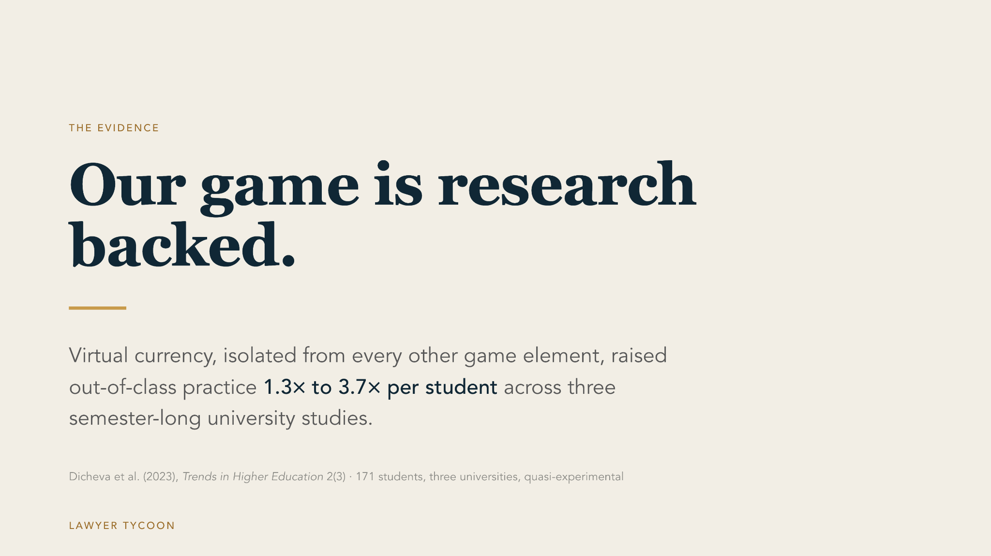
Notes:
A large study conducted by the journal of IT education, found that gamification was shown to massively improve participation and focus across a variety of subjects for university students; a plethora of other cutting-edge studies also support this conclusion.

Slide 9
PRODUCT WALKTHROUGH
07 / 08
Your Law Firm.
LAWYER TYCOON · LIVE PRODUCT DEMO
Notes:
Upgrades also change the look and feel of your law firm. As you progress, your law firm office becomes more robust, and it is a direct signal of how many LSAT questions you have answered, utilizing a proper strategy.
Alan

Slide 10
PRODUCT WALKTHROUGH
08 / 08
Progress to Higher-Tier Law Firms and Start Earning More.
LAWYER TYCOON · LIVE PRODUCT DEMO
Notes:
The goal is to get enough money to progress to the most expensive law firm.
The game is paced to be completed in around two months if the student answers 20 questions correctly every day.
Alan

Slide 11
THE GOAL
Why Lawyer Tycoon is better than the rest.
We cut down the bloat
Choices are Made for the User.
Motivates the User to Practice.
Singular Focus
LAWYER TYCOON
Notes:
Lawyer Tycoon is a better LSAT study tool than any other one out there.
First of all, we only feed the student what matters most, practice problems. We don’t give them videos or live instruction which are proven to be less effective study methods. This also greatly reduces overhead on our part.
Other apps let the user choose between type of questions which means they will tend to do the ones they feel comfortable with. And that is not efficient. We target the questions users are struggling with, making them practice what would cause the highest score improvement.
Lastly. Our game-loop motivates slacking students to keep answering questions. On our app, students will go through hundreds, if not thousands, of more questions than our competitors in the same timeframe, causing greater score improvement.
Nischay

Slide 12
⚖
LAWYER
TYCOON
THANKS FOR LISTENING
Questions?
LAWYER TYCOON · LSAT PREP, EVIDENCE-FIRST
Notes:
Nischay

